Slide 1
Python Conditional Statements
DVT101 – Lecture 8
- By Dataverse Tutorials

Slide 2
Why Conditional Statements Matter in Python
Programs need decision-making ability
Different inputs → different outputs
Backbone of logic building
Widely used in Data Science & ML

Slide 3
What Are Conditional Statements?
Control the flow of execution
Code runs only if condition is true
Based on Boolean logic (True / False)
Uses comparison operators

Slide 4
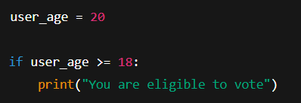
If Statement (Basic Level)
Simplest conditional statement
Executes only when condition is true
Uses indentation to define block

Slide 5
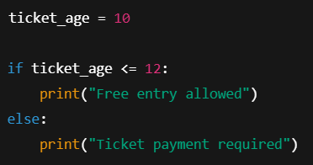
If-Else Statement
Handles both True and False cases
Ensures one block always runs
Improves decision coverage

Slide 6
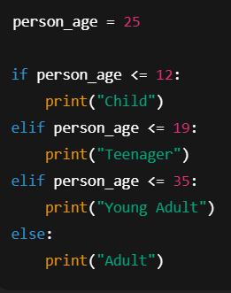
Elif Statement (Multiple Conditions)
Used for multiple condition checks
Checked sequentially (top to bottom)
First true condition executes

Slide 7
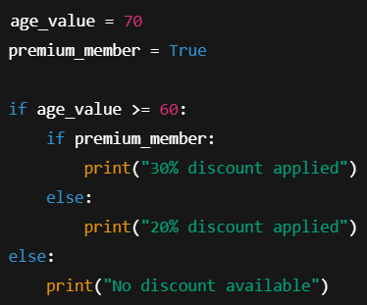
Nested If-Else
Used for dependent decisions
Common in business rules

Slide 8

Ternary Conditional Statement
One-line if-else
Clean and readable
Used for simple conditions

Slide 9
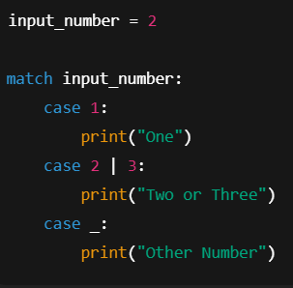
Match-Case Statement (Advanced)
Python ka switch-case version
Pattern matching based
Cleaner than long elif chains

Slide 10
Real-World & Industry Use Cases
Fraud detection rules
ML model decision thresholds
User eligibility checks
Data validation pipelines

Slide 11
Summary & Key Takeaways
Conditions control program flow
If → single condition
If-Else → two paths
Elif → multiple paths
Ternary → compact logic
Match-Case → advanced pattern matching

Slide 12


